Slide 1
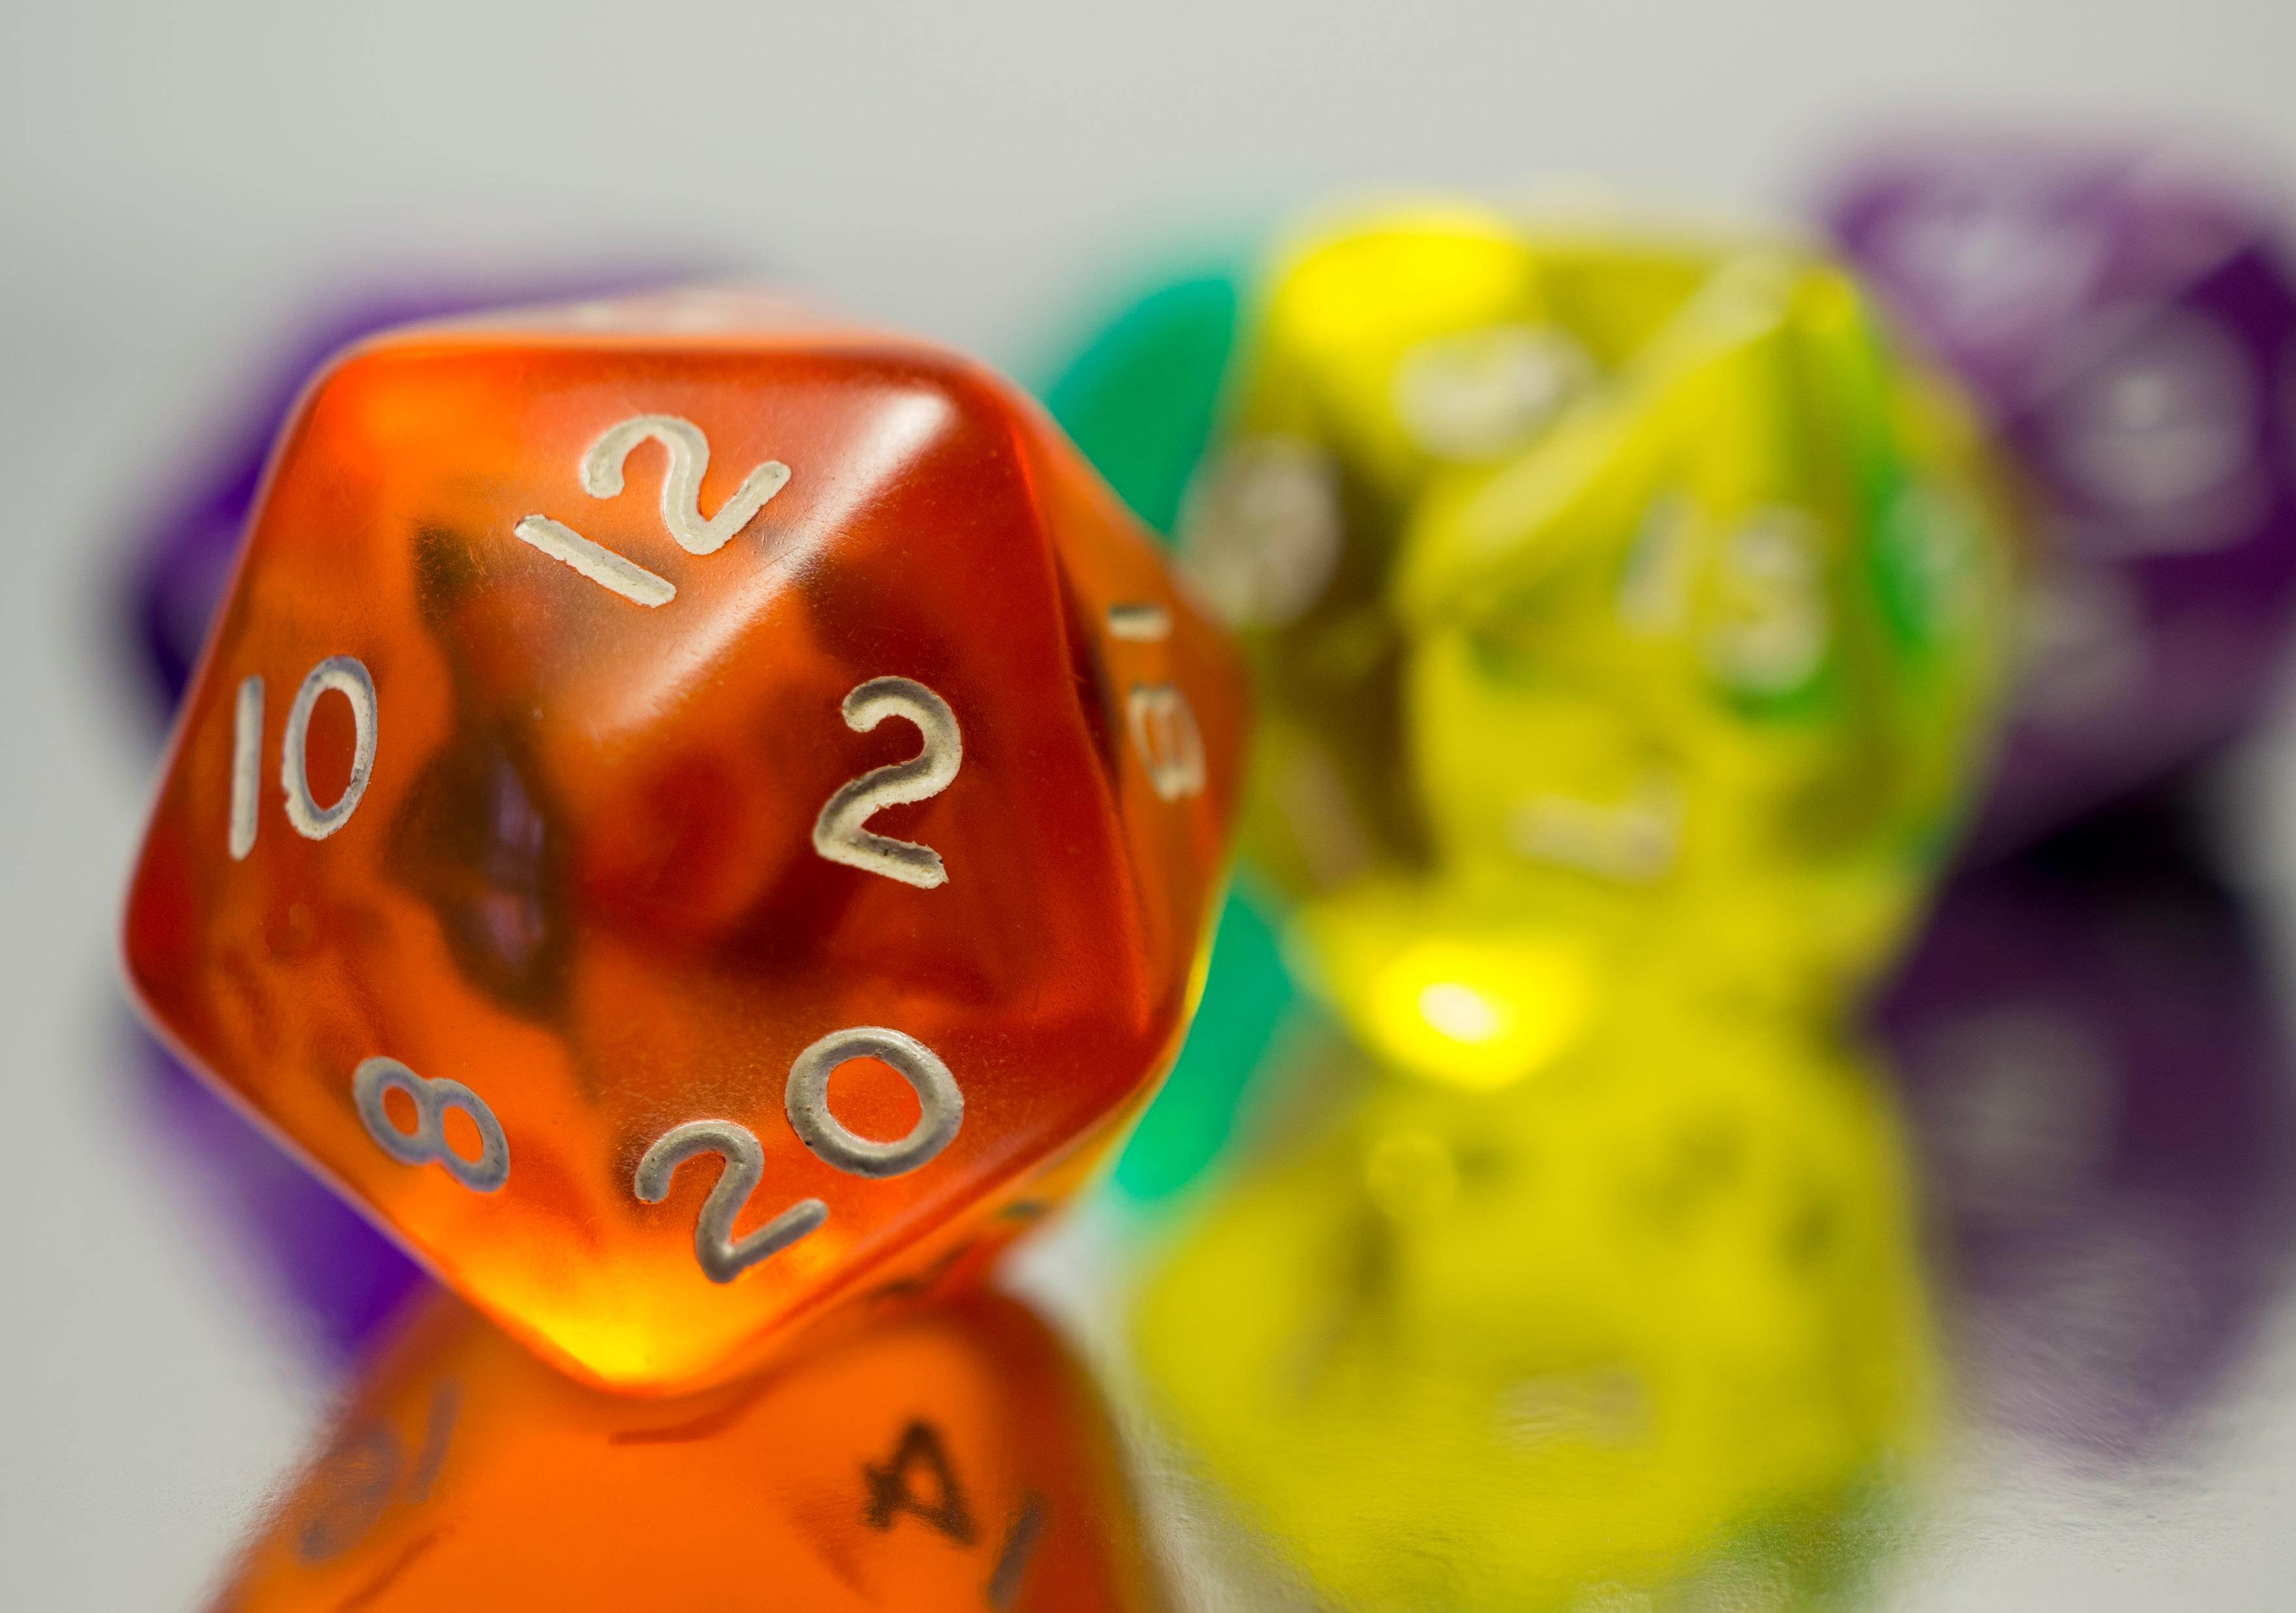
Introduction to Counting
Permutations and Combinations
Multisets and Permutations w/Repetitions
Inclusion-Exclusion Principle

Slide 2
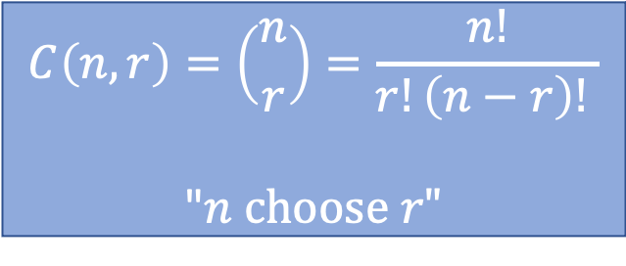
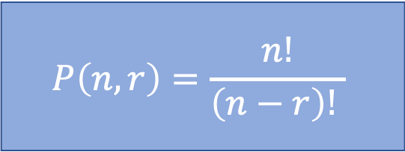
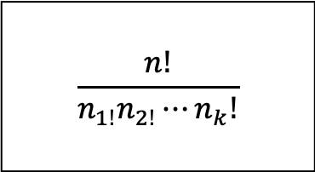
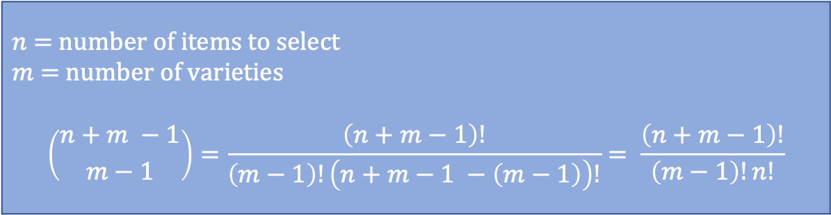
10.1 Sum and product rules
Order matters
$$P\left(n,r\right)=\frac{n!}{\left(n−r\right)! }$$
Order does not matter
$$C\left(n,r\right)=\left({n \atop r}\right)=\frac{n!}{r!\left(n−r\right)! }$$
"$n choose r"$
Introduction to counting
$$\frac{n!}{n_{1!}n_{2!}⋯n_{k}!}$$
Permutations with repetitions
Multisets / Multichoosing
$n$ = number of items to select
$m$ = number of varieties
$$\left({n+m −1 \atop m−1}\right)=\frac{\left(n+m−1\right)!}{\left(m−1\right)!\left(n+m−1 −\left(m−1\right)\right)!}= \frac{\left(n+m−1\right)!}{\left(m−1\right)!n!}$$

Slide 3
Homework Review / Exam Review
Take a few moments to share your solutions to 9.7 and 9.8
Review Exam #2 and discuss any you have questions about

Slide 4

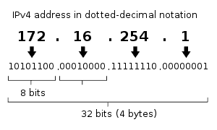
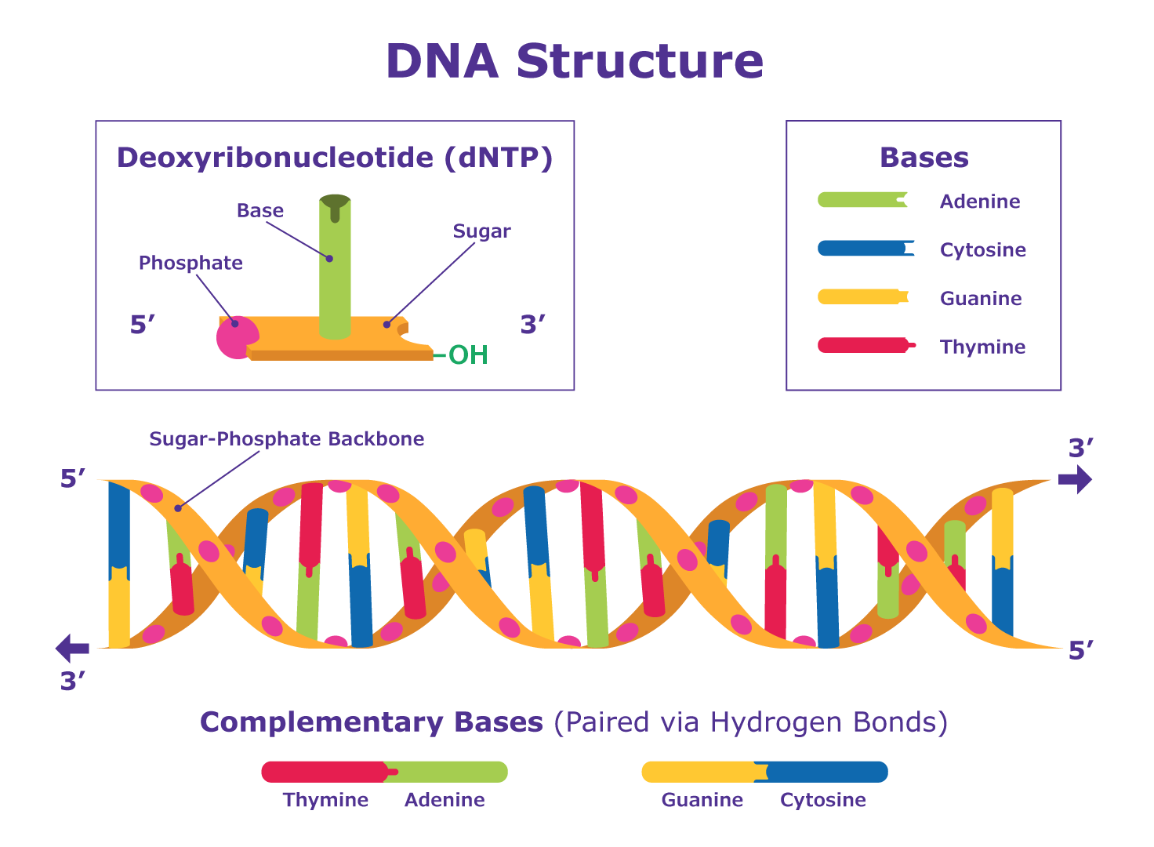
Learning how to count...again
Combinatorics – The study of the arrangement of objects
Enumeration – Counting of objects with certain properties
First came up in the study of gambling in the 1600s
Counting objects can be used to solve many problems:
How complex is this algorithm?
How many telephone numbers needed for a given population?
How many IP addresses do we need for a given region?
How complex does a password need to be?
DNA sequencing
Rosen, Kenneth. Discrete Mathematics and Its Applications, 7th Edition. McGraw-Hill, 2012

Slide 5
Tips
Play with the problem.
Try a different approach.
There is usually more than one way to arrive at the same solution.
Do as many problems as you can. Try all the additional exercises.

Slide 6
Two basic counting principles
Product Rule
Sum Rule
Rosen, Kenneth. Discrete Mathematics and Its Applications, 7th Edition. McGraw-Hill, 2012

Slide 7


Product Rule
Product Rule – both-and
Applies when a procedure is made up of multiple different tasks and each task must be completed.
If there are $n_{1}$ ways to do the first task and $n_{2}$ ways to do the second task, then there are $n_{1}n_{2}$ ways to do the procedure.
How many bitstrings of length 7? (0000000 to 1111111)
Passwords of length 8 (uppercase, lowercase, digits)?
${\left(26+26+10\right)}^{8}=$ 218340105584896
_ | _ | _ | _ | _ | _ | _
1 or 0 | 1 or 0 | 1 or 0 | 1 or 0 | 1 or 0 | 1 or 0 | 1 or 0
2 | 2 | 2 | 2 | 2 | 2 | 2
* | * | * | * | * | *
$$= 2^{7}= 128$$
Rosen, Kenneth. Discrete Mathematics and Its Applications, 7th Edition. McGraw-Hill, 2012

Slide 8




Recall - Function Classification
$$ie.F(x)=x^{2},x∈ℝ$$
What is the codomain? Does it matter?
Select all that apply.
onto
one-to-one
injection
bijection
surjection
not a function
one-to-one
onto
both one-to-one
and onto
A = B if and only if A ⊆ B and B ⊆ A
$$A⊃B$$
A $⊂B$
$$A⊇B$$

Slide 9

Product Rule - Example
one-to-one
onto
both one-to-one
and onto
Let's play musical chairs?
Suppose we have a function assigning 4 students to 8 possible seats.
Is this function One-to-one? Onto?
How many ways to assign the seats?
Ann: 8 ways to assign a seat
Bob: 7 remaining ways to assign a seat
Carl: 6 remaining ways to assign a seat
Deb: 5 remaining ways to assign a seat
$8∗7∗6∗5 = 1680$
Seat 1
Ann
Seat 2
Seat 3
Bob
Seat 4
Carl
Seat 5
Deb
Seat 6
Seat 7
Seat 8

Slide 10

How many?
How many possible bit strings of 8 bits?
$2∗2∗2∗2∗2∗2∗2∗2 = 2^{8}= 256$
How many colors can be represented using rgb, where r, g, and b values are each represented with 8 bits?
$256∗256∗256={256}^{3}=16,777,216$
How many colors with rgba?
${256}^{4}=4,294,967,296$
4 blocks of 8 bits each is 32 bits. $2^{32}=4,294,967,296$

Slide 11



How many functions?
How many possible different functions from a set with three elements to a set with five elements?
1
2
3
4
5
$$5 ∗ 5 ∗ 5 = 5^{3}= 125$$
5
5
5
a
b
c
5
4
3
How many different one-to-one functions?
$$5 ∗4 ∗3 =60$$
How many different onto functions?
None, there are only three elements in the domain but five in the codomain.
range $≠$ codomain

Slide 12

Sum Rule
Sum Rule – either-or
If a task can be done in either $n_{1}$ or $n_{2}$ ways, where none of the $n_{1}$ ways overlaps with the $n_{2}$ ways, then there are $n_{1}+n_{2}$ ways to do the task.
Examples:
How many ways to choose one letter if there are 5 vowels and 21 consonants?
5 + 21 = 26 (Choose one vowel OR one consonant)
How many ways to choose one vowel AND one consonant?
5 * 21 = 105
Suppose you can choose a final project from one of three lists. The first list contains 10 different projects, the second list contains 12 different projects, and the third list contains 5 different projects. How many possible projects are there to choose from?
10 + 12 + 5 = 27
Rosen, Kenneth. Discrete Mathematics and Its Applications, 7th Edition. McGraw-Hill, 2012

Slide 13







Practice
How many possible license plates are there given the following constraints:
Each character can be a capital letter or a digit except for 0 and 1.
Must have 7 characters.
Must begin with a letter.
Examples:
M239ABC
AD8Y7D4
Q893262
____ ____ ____ ____ ____ ____ ____
$$26$$
$$34$$
$$34$$
$$34$$
$$34$$
$$34$$
$$34$$
$$26∗34∗34∗34∗34∗34∗34=26∗{34}^{6}=40,164,914,816$$
$${remember=lower+upper+digit=\left(26+26+10\right)}^{8}$$

Slide 14
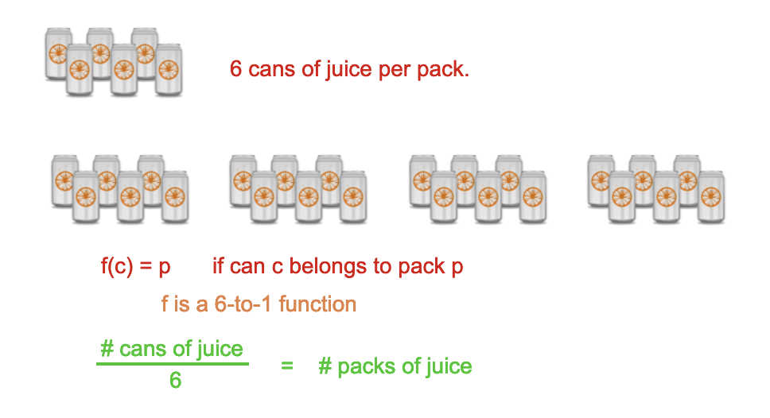
10.2 The bijection rule
Let S and T be two finite sets. If there is a bijection from S to T, then |S| = |T|.
What does bijection mean?
K-to-1 Rule:
Suppose there is a k-to-1 correspondence from a finite set A to a finite set B. Then |B| = |A|/k.
A bijection is a 1-to-1 correspondence

Slide 15
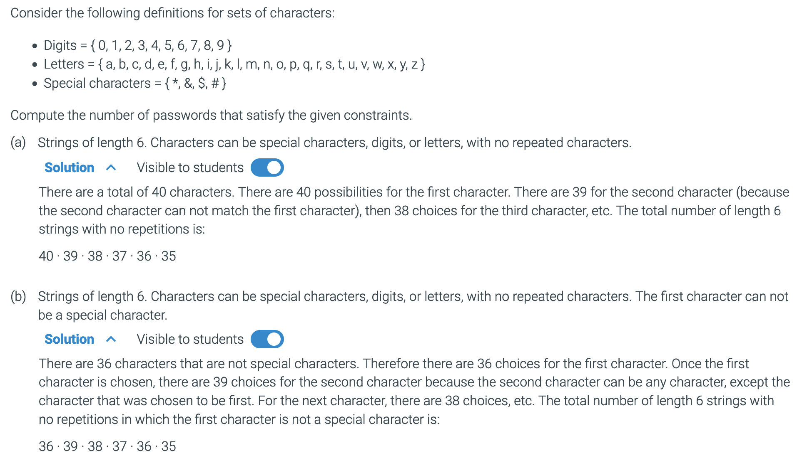
10.3.1: Counting passwords without repeating characters.

Slide 16
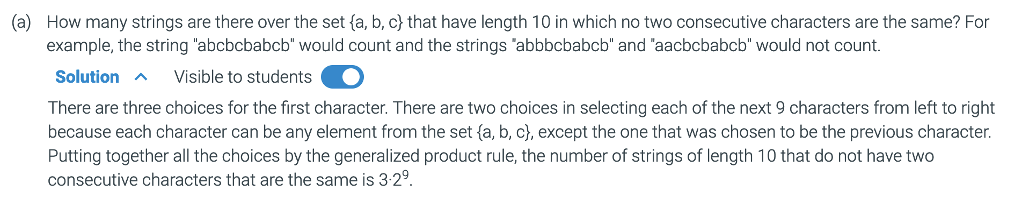
10.3.2: Strings with no repetitions
Additional Exercises:
10.3.1
10.3.2
10.3.3
10.3.4
10.4.2
10.4.3
10.5.1
10.5.2
10.5.3

Slide 17
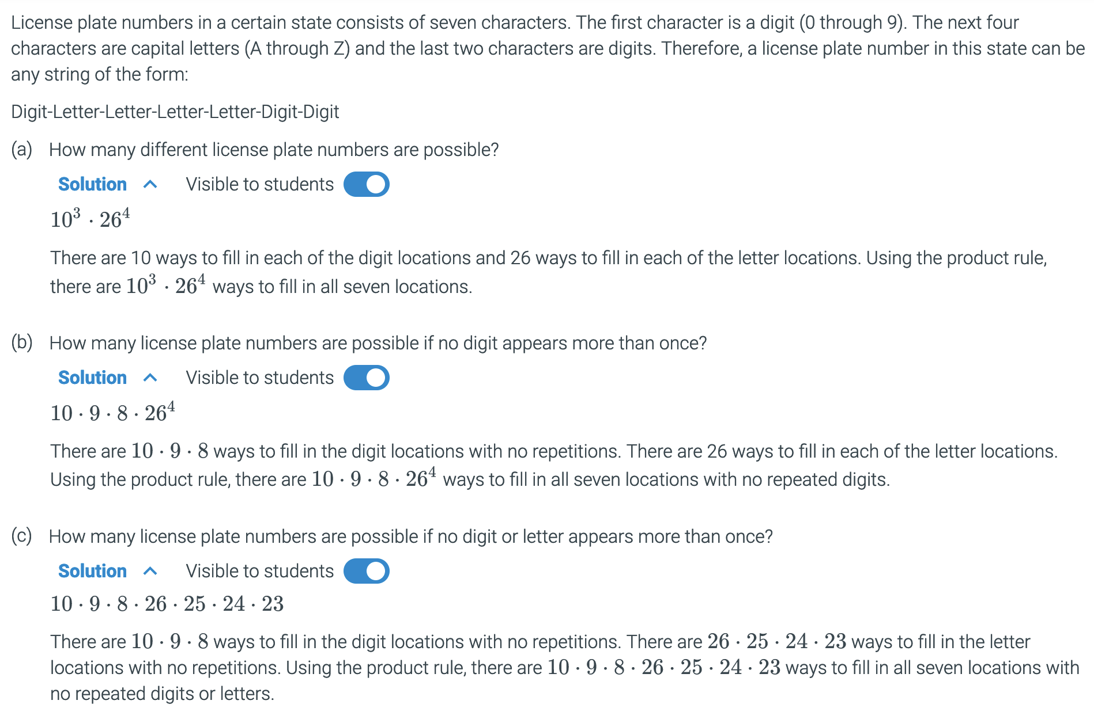
10.3.3: Counting license plate numbers.

Slide 18
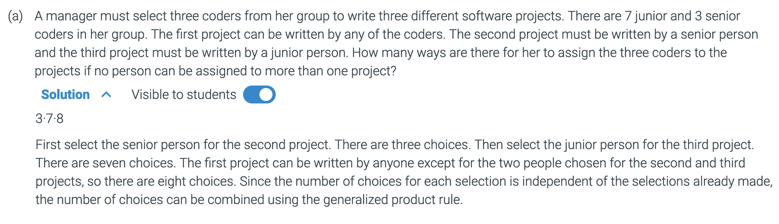
10.3.4: Selecting coders for 3 different projects.

Slide 19
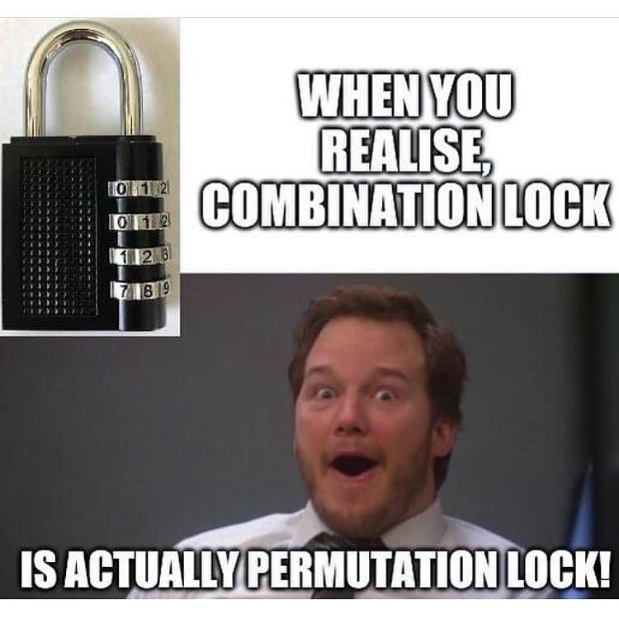

Slide 20
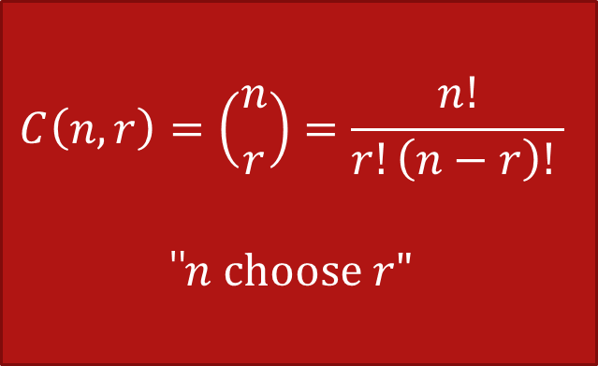
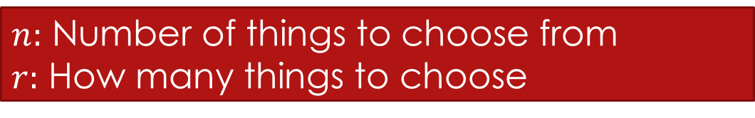
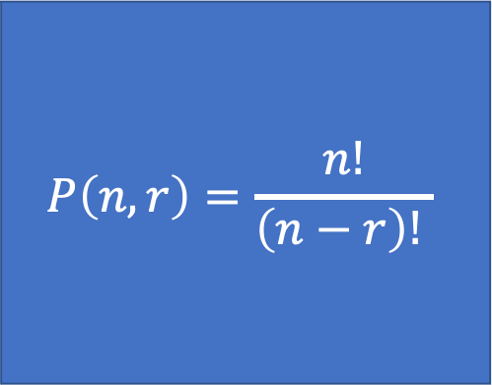
r-Permutations vs r-Combinations (Subsets)
$n:$ Number of things to choose from
$r:$ How many things to choose
Order does not matter
$$P\left(n,r\right)=\frac{n!}{\left(n−r\right)! }$$
$$C\left(n,r\right)=\left({n \atop r}\right)=\frac{n!}{r!\left(n−r\right)! }$$
"$n choose r"$
Order matters
Think sequence or arrangement
Think sets
10.4 Counting permutations

Slide 21





Permutations
Order matters
Example:
How many ways can we select three students to stand in line for a picture from a group of five students?
5 * 4 * 3 = 60
Rosen, Kenneth. Discrete Mathematics and Its Applications, 7th Edition. McGraw-Hill, 2012

Slide 22


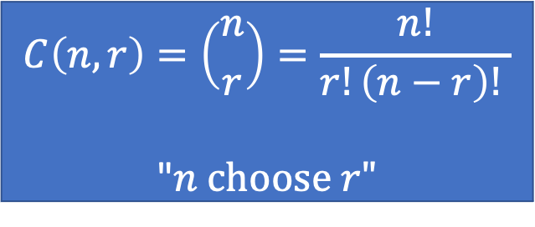
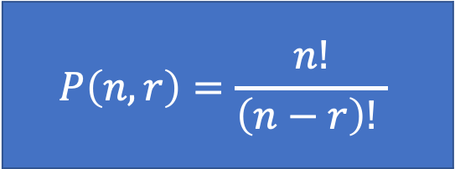

Permutations
Does order matter?
Let's come up with a formula:
$S=\{a, b, c, d, e\}$
How many ways can we choose $r$students from $S$ to stand in line?
$n=5, r= ?$
Choose 3:
$P\left(5,3\right)=$ $5 ∗4 ∗3=60$
Choose 2:
$P\left(5,2\right)=5 ∗ 4 = 20$
Order matters
$$P\left(n,r\right)=\frac{n!}{\left(n−r\right)! }$$
/
/
$$\frac{5∗4 ∗3 ∗2 ∗1}{2 ∗1}=\frac{5!}{(5−3)!}=\frac{5!}{2!}=\frac{120}{2}=60$$
/
/
Order does not matter
/
/
/
$$C\left(n,r\right)=\left({n \atop r}\right)=\frac{n!}{r!\left(n−r\right)! }$$
"$n choose r"$
$$\frac{5∗4 ∗3 ∗2 ∗1}{3 ∗ 2 ∗1}=\frac{120}{6}=20$$
/
/
/

Slide 23


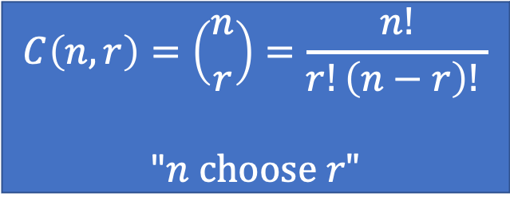
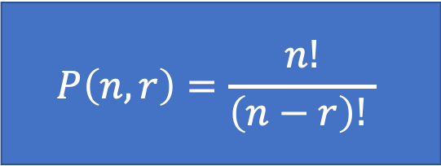
Combinations (AKA Choosing AKA Subsets)
Order matters
$$P\left(n,r\right)=\frac{n!}{\left(n−r\right)! }$$
Order does not matter
$$C\left(n,r\right)=\left({n \atop r}\right)=\frac{n!}{r!\left(n−r\right)! }$$
"$n choose r"$
Order does not matter
Example:
There are 4 students at a table. We need to form a party planning committee of three students from that table. How many different possible committees are there?
$\{ann, bob, carl, deb\}$
$\left\{bob, carl, deb\right\}, \left\{ann, carl, deb\right\}, \left\{ann, bob, deb\right\}, \{ann, bob, carl\}$
Rosen, Kenneth. Discrete Mathematics and Its Applications, 7th Edition. McGraw-Hill, 2012

Slide 24


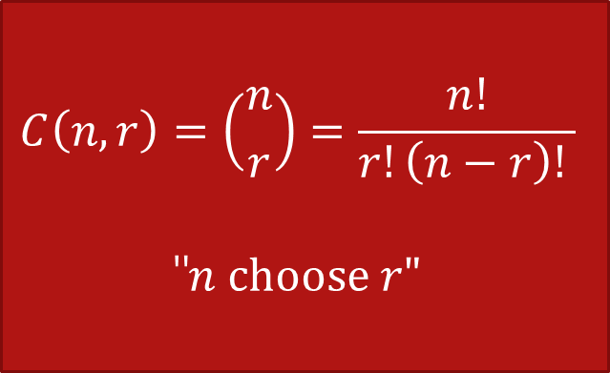
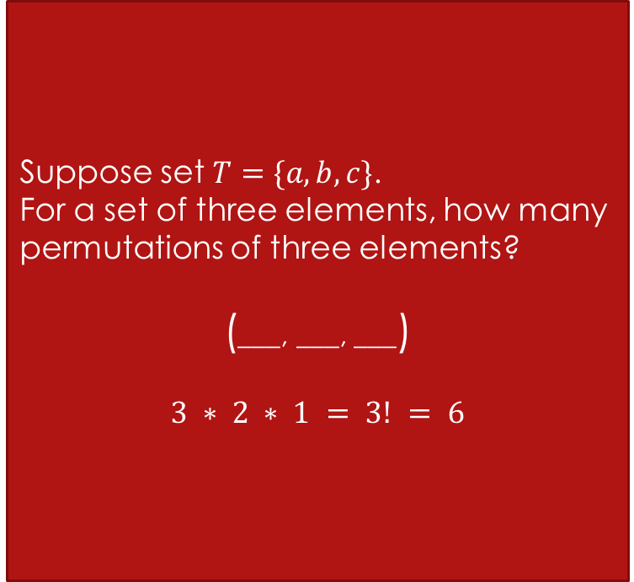

Combinations
Suppose set $T=\{a,b,c\}$.
For a set of three elements, how many permutations of three elements?
(___, ___, ___)
$$3 ∗ 2 ∗ 1 = 3! = 6$$
$$−d$$ | $−c$ | $−b$ | $−a$
$$\left(a,b,c\right)$$ | $\left(a,b,d\right)$ | $\left(a,c,d\right)$ | $\left(b,c,d\right)$
$$\left(a,c,b\right)$$ | $\left(a,d,b\right)$ | $\left(a,d,c\right)$ | $\left(b,d,c\right)$
$$\left(b,a,c\right)$$ | $\left(b,a,d\right)$ | $\left(c,a,d\right)$ | $\left(c,b,d\right)$
$$\left(b,c,a\right)$$ | $\left(b,d,a\right)$ | $\left(c,d,a\right)$ | $\left(c,d,b\right)$
$$\left(c,a,b\right)$$ | $\left(d,a,b\right)$ | $\left(d,a,c\right)$ | $$\left(d,b,c\right)$$
$$\left(c,b,a\right)$$ | $\left(d,b,a\right)$ | $\left(d,c,a\right)$ | $$\left(d,c,b\right)$$
$S=\{a,b,c,d\}$
How many permutations of 3? (order matters)
$P\left(4,3\right)=\frac{4!}{\left(4−3\right)!}=\frac{4∗3∗2∗1}{1}=24$
How many combinations of 3? (order does not matter)
We can calculate the number of permutations, then from those 24, we need to remove or "divide out" all the ones that are counted multiple times.
$C\left(4,3\right)= \frac{4!}{3!\left(4−3\right)!}=\frac{4∗3∗2∗1}{(3∗2∗1)(1)}= \frac{24}{6}=4$
(___, ___, ___)
4 * 3 * 2
$$C\left(n,r\right)=\left({n \atop r}\right)=\frac{n!}{r!\left(n−r\right)! }$$
"$n choose r"$
$$−d$$ | $−c$ | $−b$ | $−a$
$\left\{a,b,c\right\}$ | $\left\{a,b,d\right\}$ | $\left\{a,c,d\right\}$ | $\left\{b,c,d\right\}$
$$\left(a,c,b\right)$$ | $\left(a,d,b\right)$ | $\left(a,d,c\right)$ | $\left(b,d,c\right)$
$$\left(b,a,c\right)$$ | $\left(b,a,d\right)$ | $\left(c,a,d\right)$ | $\left(c,b,d\right)$
$$\left(b,c,a\right)$$ | $\left(b,d,a\right)$ | $\left(c,d,a\right)$ | $\left(c,d,b\right)$
$$\left(c,a,b\right)$$ | $\left(d,a,b\right)$ | $\left(d,a,c\right)$ | $$\left(d,b,c\right)$$
$$\left(c,b,a\right)$$ | $\left(d,b,a\right)$ | $\left(d,c,a\right)$ | $$\left(d,c,b\right)$$
subsets

Slide 25
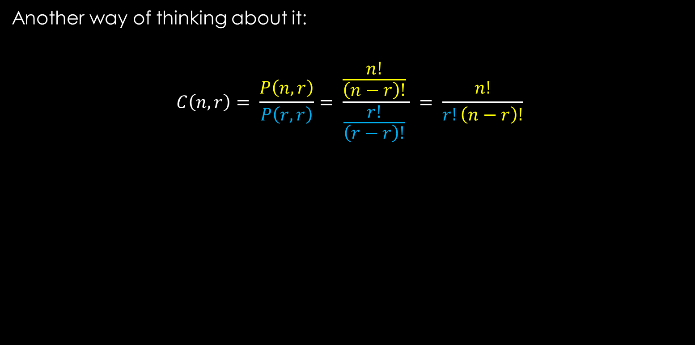
Combinations
Permutation
Another way of thinking about it:
$$C\left(n,r\right)= \frac{P\left(n,r\right)}{P\left(r,r\right)}= \frac{\frac{n!}{\left(n−r\right)!} }{\frac{r!}{\left(r−r\right)!} } = \frac{n!}{r!\left(n−r\right)!}$$
Divide out the permutation of each combination

Slide 26




Combinations
Does order matter?
Let's come up with a formula:
$S=\{a, b, c, d,e\}$
How many ways can we choose $r$students from $S$ to form a committee?
$n=5, r= ?$
Since order does not matter, think of sets. How many subsets of $S$ contain $r$ elements?
Choose 3:
$C\left(5,3\right)=$ $\frac{5 ∗4 ∗3}{3∗2}=10$
$$C\left(n,r\right)=\left({n \atop r}\right)=\frac{n!}{r!\left(n−r\right)! }$$
"$n choose r"$
$$\frac{5∗4 ∗3 ∗2 ∗1}{ \left(3 ∗2∗1\right)\left(2 ∗1\right) }=\frac{5!}{3!2!}=\frac{120}{6}=10$$

Slide 27


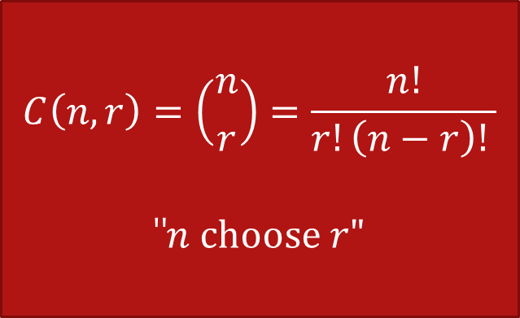

Combinations
$$C\left(n,r\right)=\left({n \atop r}\right)=\frac{n!}{r!\left(n−r\right)! }$$
"$n choose r"$
$S= \{a,b,c,d,e\}$
Try listing out all the possible subsets with three elements. How many are there?
There are 10
$$\{a,b,c\}$$ | $$\{b,c,d\}$$ | $$\{c,d,e\}$$
$$\{a,b,d\}$$ | $$\{b,c,e\}$$
$$\{a,b,e\}$$ | $$\{b,d,e\}$$
$$\{a,c,d\}$$
$$\{a,c,e\}$$
$$\{a,d,e\}$$
$n=5$
$r=3$
$C\left(5,3\right)=\frac{5!}{3!2!}=\frac{120}{12}=10$

Slide 28




A group of 30 people have been trained as astronauts for the first mission to Mars. How many ways are there to select a crew of 6 people (assuming all 30 people are interchangeable)?
This is the same thing as the number of subsets of 6 elements from a set of 30 elements. Since order does not matter, we use Combinations.
$$C\left(30,6\right)= \left({30 \atop 6}\right)= \frac{30!}{6!24!}= \frac{30∙29∙28∙27∙26∙25}{6∙5∙4∙3∙2∙1}=593,775$$
$$\left({n \atop r}\right)=\frac{n!}{r!\left(n−r\right)! }$$
$$\left({n \atop k}\right)$$
Python
Rosen, Kenneth. Discrete Mathematics and Its Applications, 7th Edition. McGraw-Hill, 2012

Slide 29





Jury Duty Time!
$$\left({n \atop r}\right)=\frac{n!}{r!(n−r)!}$$
Imagine it is determined that the ideal jury consists of 5 men and 7 women. There are 18 men and 16 women in the jury pool.
How many possible juries are there?
$$\left({m \atop r}\right)\left({w \atop s}\right)$$
$$\left({18 \atop 5}\right)\left({16 \atop 7}\right)$$
98,017,920
$$\frac{18!}{5!13!}= \frac{18∗17∗16∗15∗14}{5∗4∗3∗2∗1}=8568$$
$$\frac{16!}{7!9!}= \frac{16∗15∗14∗13∗12∗11∗10}{7∗6∗5∗4∗3∗2∗1}=11440$$

Slide 30
10.4.2: Counting telephone numbers.
At a certain university in the U.S., all phone numbers are 7-digits long and start with either 824 or 825.
(a) How many different phone numbers are possible?
There are two choices for the first three digits (824 or 825). Each of the remaining 4 digits can be any one of the ten digits, so there are 10⁴ ways to pick the last four digits. The total number of 7-digit phone numbers that start with 824 or 825 is 2·10⁴.
(b) How many different phone numbers are there in which the last four digits are all different?
There are two choices for the first three digits (824 or 825). In selecting the remaining 4 digits, 4 digits are selected from a set of 10 with no repetitions, so there are P(10, 4) choices. The total number of 7-digit phone numbers that start with 824 or 825 and have no repeated digits among the last four digits is 2·P(10, 4).

Slide 31
10.4.3: Lining up club members for a photo.
How to set up the problem? Not solve
Permutation or Combinations
Ten members of a club are lining up in a row for a photograph. The club has one president, one VP, one secretary, and one treasurer.
(a) How many ways are there to line up the ten people?
A line-up of the ten people is just a permutation of ten distinct items/people. There are 10! ways to order ten people.
(b) How many ways are there to line up the ten people if the VP must be beside the president in the photo?
Decide whether the VP is to the left or the right of the president (two choices). Now, for each choice, find an ordering of the 9 items, where the 9 items consist of the 8 people in the club besides the president and VP and the unit consisting of the president and VP stuck together. There are 9! ways to permute 9 distinct items. Therefore the number of ways to line up the ten people so that the VP is beside the president is 2·9!.
(c) How many ways are there to line up the ten people if the president must be next to the secretary and the VP must be next to the treasurer?
Decide whether the president is to the left or the right of the secretary (two choices). Once that decision is made, the president and secretary will be stuck together. Decide whether the VP is to the left or the right of the treasurer (two choices). Once that decision is made, the VP and treasurer will be stuck together. Now find an ordering of the 8 items, where the 8 items consist of the president/secretary unit, the VP/treasurer unit and the other 6 members of the club. There are 8! ways to permute 8 distinct items. Therefore the number of ways to line up the ten people with the president next to the secretary and the VP next to the treasurer is 2·2·8!.

Slide 32
10.5.1: Mapping permutations to subsets.
Consider a function f that maps 5-permutations from the set S = {1, …, 20} to 5-subsets from S. The function takes a 5-permutation and creates an unordered set whose elements are the five numbers included in the permutation.
(a) What is the value of f on input (12, 1, 3, 15, 9)?
{1, 3, 9, 12, 15}
(b) Is (12, 3, 12, 4, 19) a 5-permutation? Why or why not?
No because 12 appears twice.
(c) How many permutations are mapped onto the subset {12, 3, 13, 4, 19}?
5! because there are 5! ways to order the elements in {12, 3, 13, 4, 19}.

Slide 33
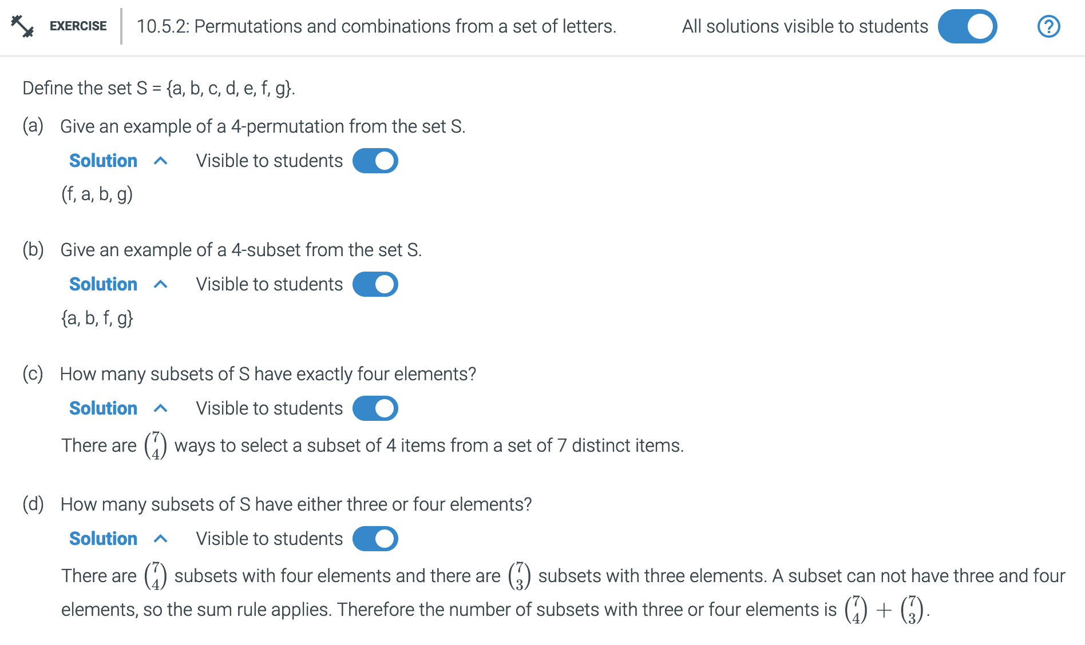

Slide 34
10.5.3: Counting bit strings.
How many 10-bit strings are there subject to each of the following restrictions?
(a) No restrictions.
Two choices for each of the 10 bits: 2¹⁰ binary strings of length 10.
(b) The string starts with 001.
The first three bits of the string are determined. Each of the remaining 7 bits can be 0 or 1. Therefore there are 2⁷ binary strings of length 10 that start with 001.
(c) The string starts with 001 or 10.
There are 2⁷ 10-bit strings that begin with 001. There are 2⁸ 10-bit strings that begin with 10. A string can not begin with 001 and 10, so the sum rule applies. Therefore the number of 10-bit strings that begin with 001 or 10 is 2⁷ + 2⁸.
(d) The first two bits are the same as the last two bits.
Each of the first 8 bits can be either 0 or 1. Once the first 8 bits are determined, the last two bits must match the first two bits, so there are no remaining choices for the string. Thus, the number of strings in which the first two bits are the same as the last two bits is 2⁸.
(e) The string has exactly six 0's.
There are ways to select where the six 0's will be placed among the ten possible locations. Once the 0's are placed, the four 1's go in the unfilled locations. Therefore the number of 10-bit strings with exactly six 0's is .
(f) The string has exactly six 0's and the first bit is 1.
The six 0's can be placed in any of the 10 locations, except the first location. There are
ways to select the six locations for the 0's among the last nine locations in the string. Once the 0's are placed, the four 1's go in the unfilled locations. Therefore the number of 10-bit strings with exactly six 0's and a 1 in the first location is .
(g) There is exactly one 1 in the first half and exactly three 1's in the second half.
There are ways to select the location for the 1 among the first five locations. There are ways to select the location for the three 1's among the last five locations. Once the 1's are placed, the 0's go in all the unfilled locations. Since the location for the 1 in the first half and the locations for the 1's in the second half must both be determined to specify the string, the product rule applies. Therefore the number of 10-bit strings with one 1 in the first half and three 1's in the second half is .

Slide 35
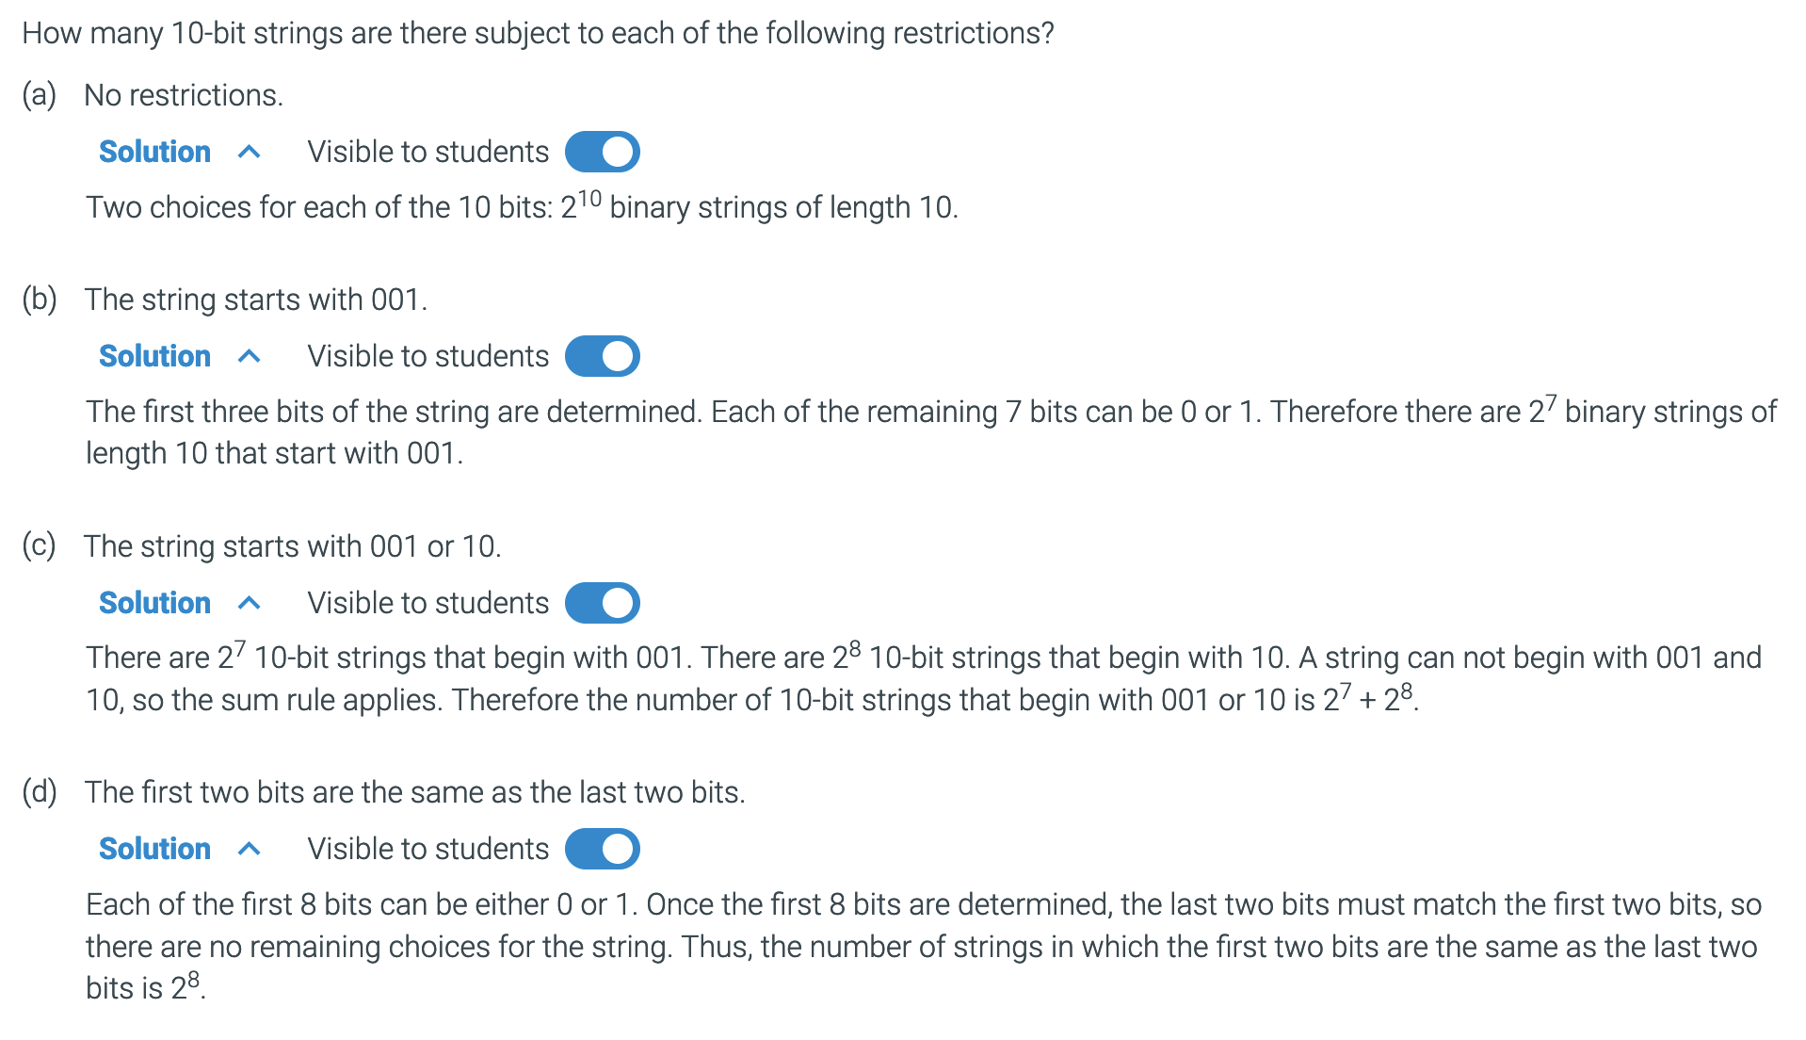
10.5.3: Counting bit strings.

Slide 36
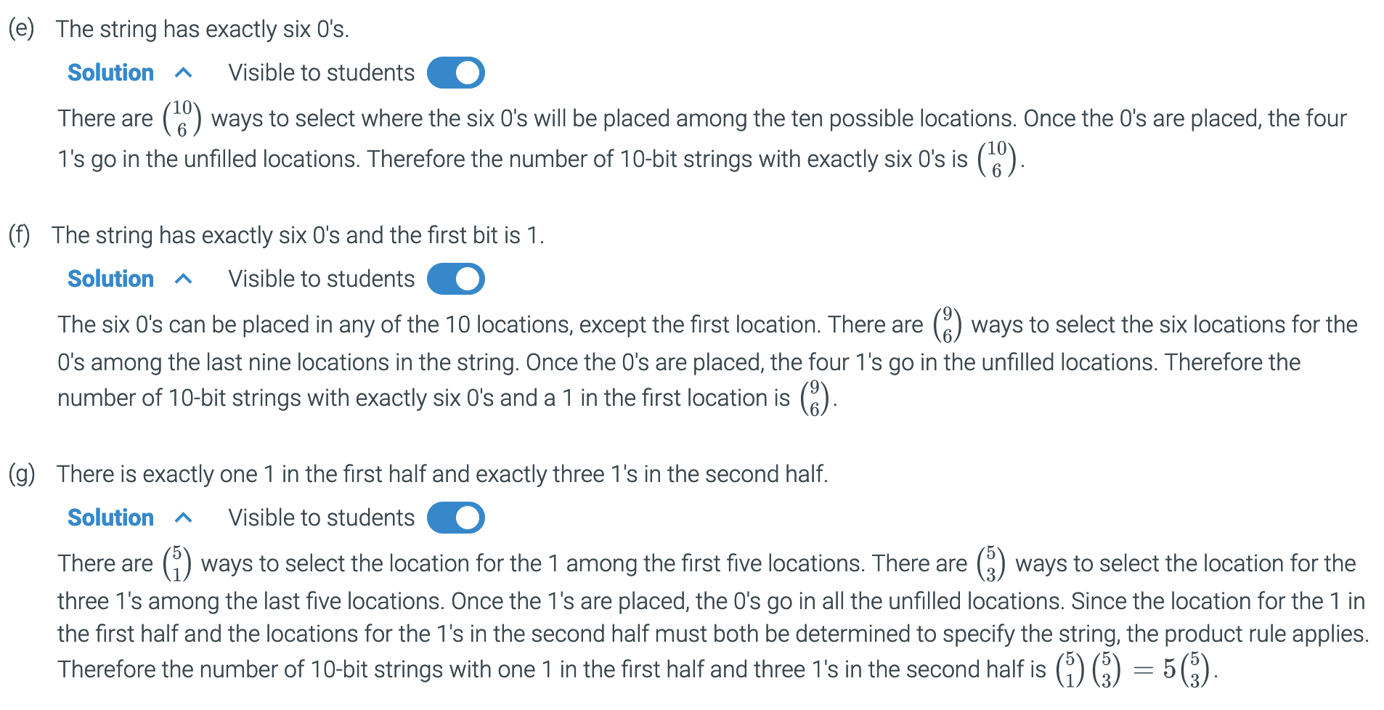
10.5.3: Counting bit strings.

Slide 37






Dealing with large factorials
$$11$$
$$16$$
$$\frac{33!}{30!3!}$$
$$= \frac{33∗32∗31 ∗30!}{30!∗3!}$$
$$= \frac{33∗32∗31}{3∗2}$$
$$=11∗16∗31=5456$$
Much simpler!

Slide 38
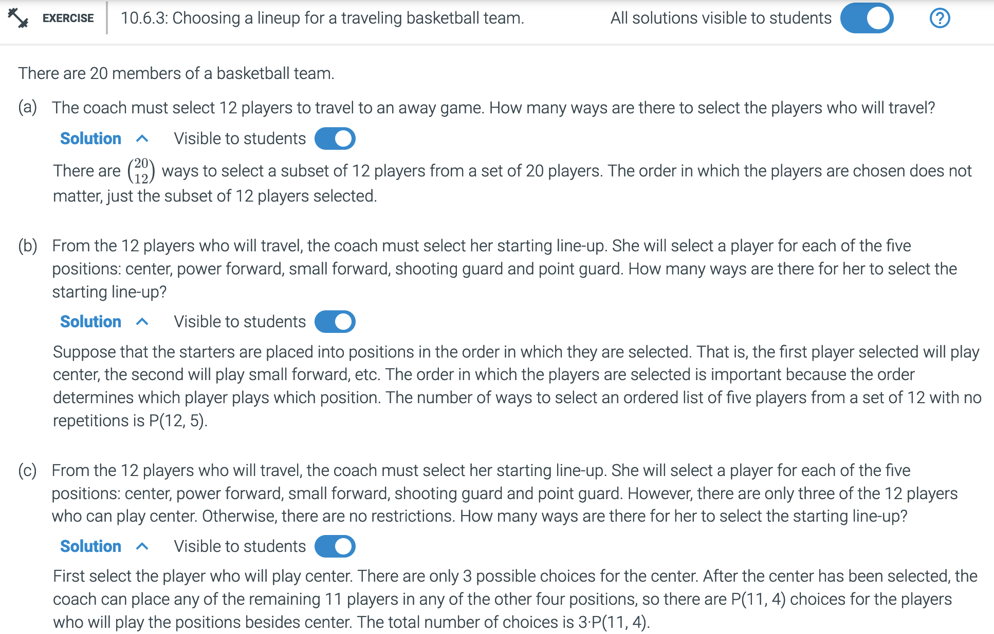

Slide 39
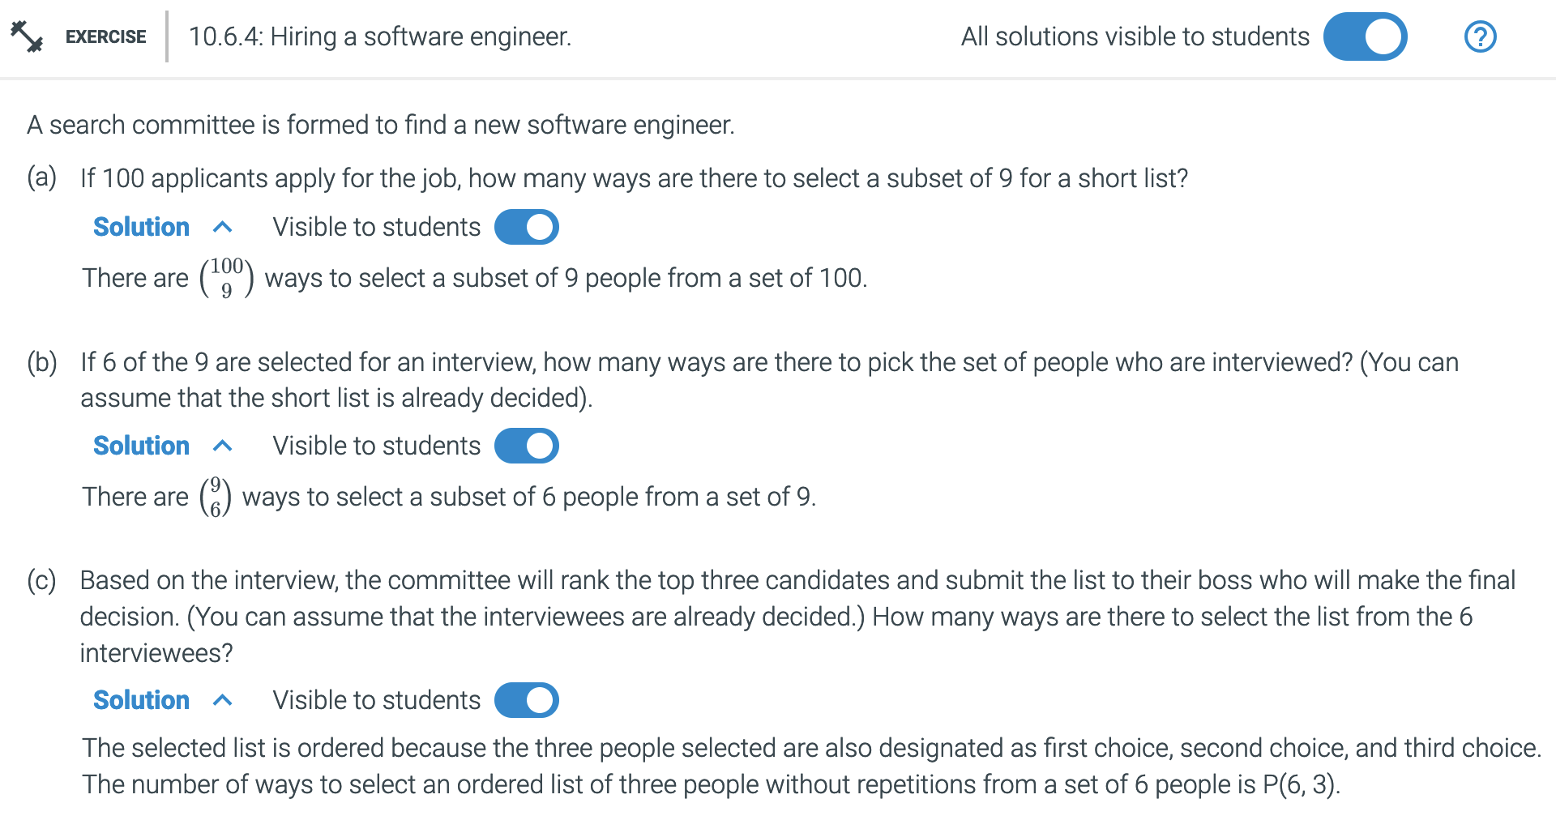

Slide 41



Counting by Complement
How many 8-bit strings do not begin with 01?
1. How many 8-bit strings are there with no restrictions?
$$2^{8}$$
2. How many 8-bit strings DO begin with 01?
01_ _ _ _ _ _ $2^{6}$
3. Subtract
$2^{8}−2^{6}=192$
10.7 Counting by complement

Slide 42
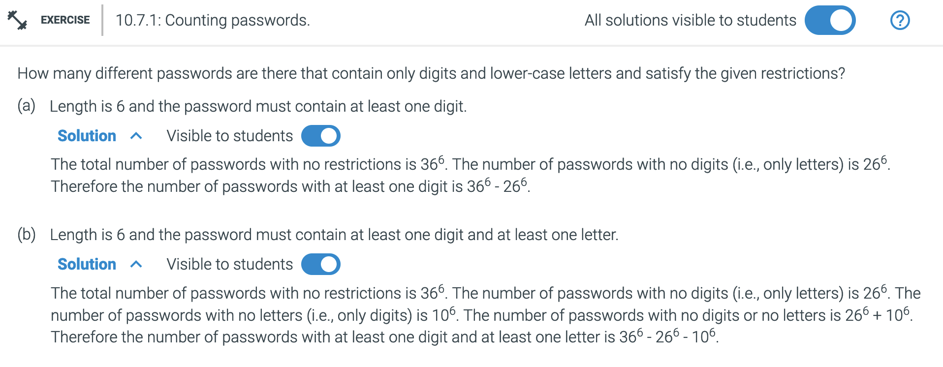

Slide 43
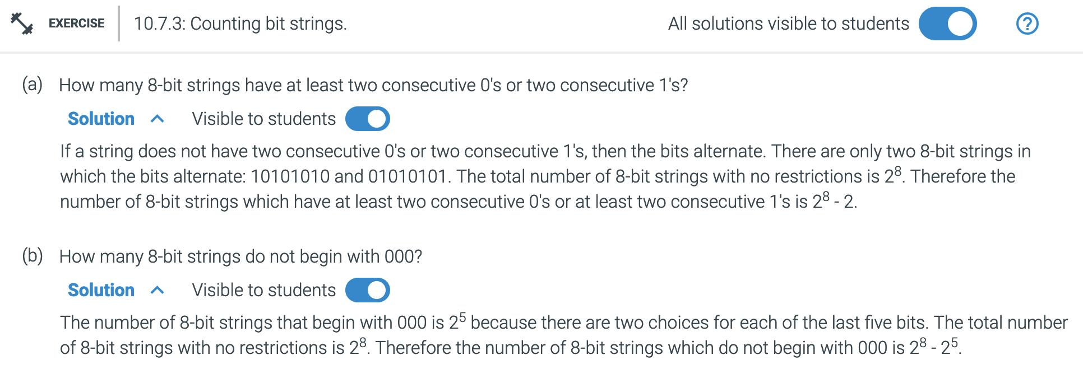

Slide 44
Review
Order matters
$$P\left(n,r\right)=\frac{n!}{\left(n−r\right)! }$$
Order does not matter
$$C\left(n,r\right)=\left({n \atop r}\right)=\frac{n!}{r!\left(n−r\right)! }$$
"$n choose r"$
C(n,r) is a subset of P(n,r)
Counting by complement
No restriction – restrictions* =>
Repetitions - subset/special case of C(n,r)
Repeats of the options n+ S= {1,1,2,2,3,3}
More pulls than options: r>n S ={1,2,3} r=(1,2,3,3)

Slide 45
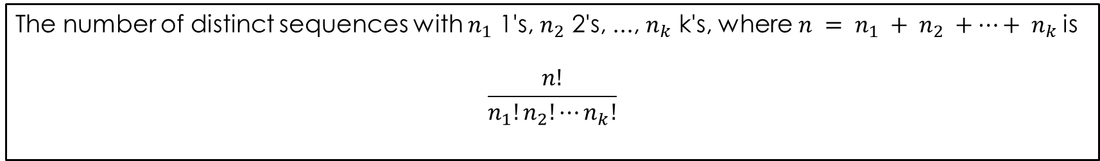

Permutations with repetitions
How many ways can you order the letters in the word MATHEMATICS?
Note there are 2 M's, 2 A's, and 2 T's. There are 11 letters total.
Therefore, we have $\frac{11!}{2!2!2!1!1!1!1!1!}=\frac{11!}{8}=4989600$
The number of distinct sequences with $n_{1}$ 1's, $n_{2}$ 2's, ..., $n_{k}$ k's, where $n = n_{1} + n_{2} +…+ n_{k}$is
$$\frac{n!}{n_{1}!n_{2}!⋯n_{k}!}$$
10.8 Permutations with repetitions

Slide 46
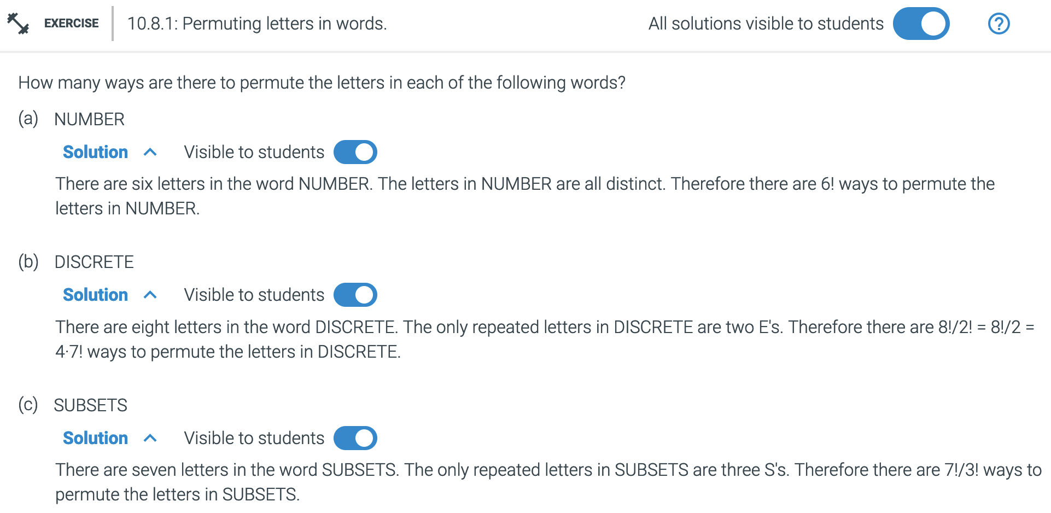
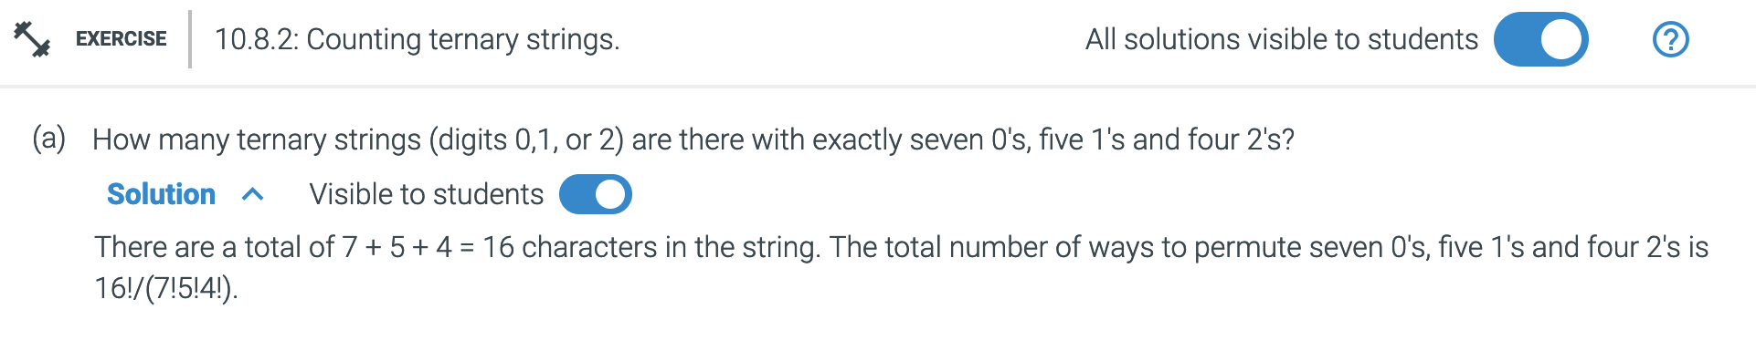

Slide 47

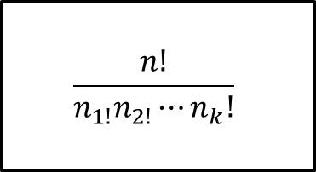



Permutations with repetitions
$$\frac{n!}{n_{1!}n_{2!}⋯n_{k}!}$$
How many bit strings with three 0's and five 1's?
00011111
$$\frac{8!}{5!3!}=$$
$$\frac{8⋅7⋅6⋅5!}{5!3!}$$
$$=\frac{8⋅7⋅6}{3⋅2⋅1}$$
$$=8⋅7=56$$

Slide 48
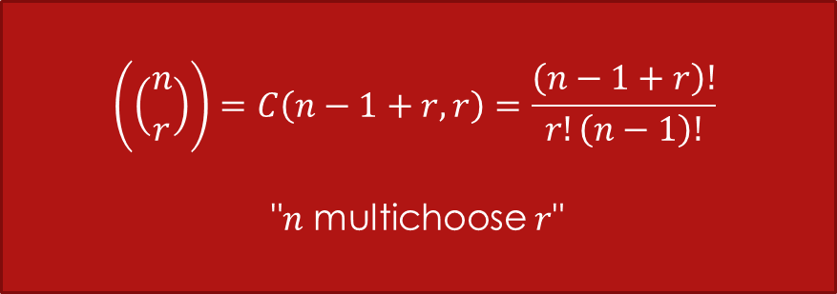

Multisets / Multichoosing
Subsets with repetition allowed. Order does not matter.
$S=\{a,b,c,d,e\}$
Some of the ways to choose a subset of three elements:
$\left\{a,b,c\right\}$
$\left\{a,a,a\right\}$
$\left\{a,b,b\right\}$
$\left\{c,e,e\right\}$
$$\left(\left({n \atop r}\right)\right)=C\left(n−1+r, r\right)=\frac{\left(n−1+r\right)!}{r!\left(n−1\right)!}$$
"$n$ multichoose $r$"

Slide 49
Order matters
$$P\left(n,r\right)=\frac{n!}{\left(n−r\right)! }$$
Order does not matter
$$C\left(n,r\right)=\left({n \atop r}\right)=\frac{n!}{r!\left(n−r\right)! }$$
"$n choose r"$
C(n,r) is a subset of P(n,r)
Counting by complement
No restriction – restrictions* =>
Repetitions - subset/special case of C(n,r)
Repeats of the options n+ S= {1,1,2,2,3,3}
More pulls than options: r>n S ={1,2,3} r=(1,2,3,3)
$$\frac{n!}{n_{1!}n_{2!}⋯n_{k}!}$$

Slide 50
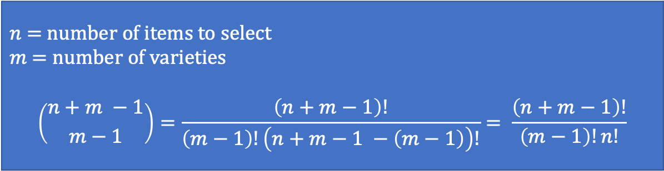

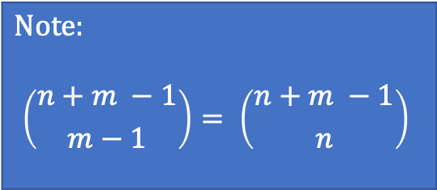
Multisets / Multichoosing
Order matters
$$P\left(n,r\right)=\frac{n!}{\left(n−r\right)! }$$
Order does not matter
$$C\left(n,r\right)=\left({n \atop r}\right)=\frac{n!}{r!\left(n−r\right)! }$$
"$n choose r"$
Subsets with repetition allowed. Order does not matter.
$S=\{a,b,c,d,e\}$
Some of the ways to choose a subset of three elements:
$\left\{a,b,c\right\}$
$\left\{a,a,a\right\}$
$\left\{a,b,b\right\}$
$\left\{c,e,e\right\}$
$$Note:$$
$$\left({n+m −1 \atop m−1}\right)= \left({n+m −1 \atop n}\right)$$
n = |S|
m = |x|
Remember: The product rule and the sum rule
$n$ = number of items to select
$m$ = number of varieties
$$\left({n+m −1 \atop m−1}\right)=\frac{\left(n+m−1\right)!}{\left(m−1\right)!\left(n+m−1 −\left(m−1\right)\right)!}= \frac{\left(n+m−1\right)!}{\left(m−1\right)!n!}$$
10.9 Counting multisets

Slide 51
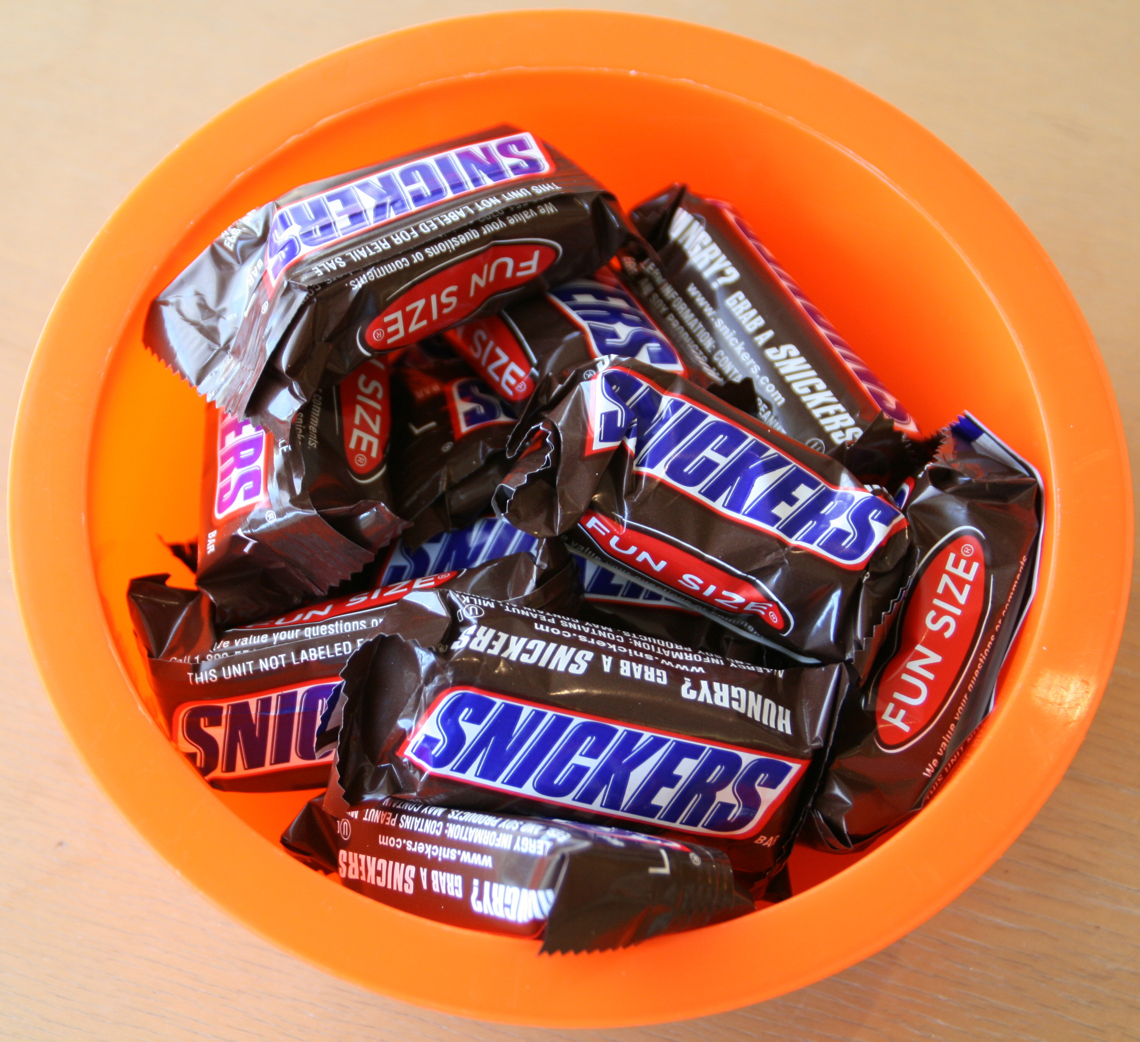




Snack time!
$$\left(\left({n \atop r}\right)\right)=\frac{\left(n−1+r\right)!}{r!\left(n−1\right)!}$$
How many ways can we select four candy bars from a bowl containing Snickers, Twix, and Butterfingers? Assume order does not matter and repetition is allowed. There are at least 4 of each type of candy bar in the bowl.
$$\left(\left({n \atop k}\right)\right)$$
$$\left(\left({3 \atop 4}\right)\right)$$
$$\left({6 \atop 4}\right)= \frac{6!}{4!2!}= \frac{6∗5}{2}=15$$
Rosen, Kenneth. Discrete Mathematics and Its Applications, 7th Edition. McGraw-Hill, 2012

Slide 52




Snack time!
Order does not matter
$$\left({n+m −1 \atop m−1}\right)$$
$$C\left(n,r\right)=\left({n \atop r}\right)=\frac{n!}{r!\left(n−r\right)! }$$
"$n choose r"$
How many ways can we select 4 candy bars from a bowl containing Snickers, Twix, and Butterfingers? Assume order does not matter and repetition is allowed. There are at least 4 of each type of candy bar in the bowl.
$n$ = number of items to select
$m$ = number of varieties
$n=4$ (selecting four candy bars)
$m=3$ (there are three kinds to choose from)
$$\left({n+m−1 \atop m−1}\right)= \left({6 \atop 2}\right)$$
$$\left({6 \atop 2}\right)= \frac{6!}{2!4!}= \frac{6∗5}{2}=15$$
Rosen, Kenneth. Discrete Mathematics and Its Applications, 7th Edition. McGraw-Hill, 2012

Slide 53





Number of Solutions to a Fixed Sum
$$\left({n+m −1 \atop m−1}\right)$$
Order does not matter
$$C\left(n,r\right)=\left({n \atop r}\right)=\frac{n!}{r!\left(n−r\right)! }$$
"$n choose r"$
Count the number of solutions to the equation
$x_{1}+x_{2}+x_{3}=4$
This is the same problem as selecting 4 items from 3 varieties, where we have $x_{1}$ of the first variety, $x_{2}$ of the second variety, and $x_{3}$ of the third variety. This is the same problem as the candy bar problem.
$n=4$
$m=3$
$$\left({4+3 −1 \atop 3−1}\right)= \left({6 \atop 2}\right)$$
$$\left({6 \atop 2}\right)= \frac{6!}{2!4!}= \frac{6∗5}{2}=15$$

Slide 54




Try it
$$\left({n+m −1 \atop m−1}\right)$$
Order does not matter
$$C\left(n,r\right)=\left({n \atop r}\right)=\frac{n!}{r!\left(n−r\right)! }$$
"$n choose r"$
Now what if we select 15 bars?
Count the number of solutions to the equation
$x_{1}+x_{2}+x_{3}=15$
Now we are selecting 15 items from 3 varieties, where we have $x_{1}$ of the first variety, $x_{2}$ of the second variety, and $x_{3}$ of the third variety.
$n=15$
$m=3$
$$\left({15+3 −1 \atop 3−1}\right)= \left({17 \atop 2}\right)$$
$$\frac{17!}{2!15!}= \frac{17∗16}{2}=136$$

Slide 55

Handshakes
$$\left({n+m −1 \atop m−1}\right)$$
There are 110 people at a meeting. They each shake hands with everyone else. How many handshakes were there? Is it a permutation or subset, and how many options are there?
Each handshake consists of 2 people.
How many subsets of 2 people are there? This is the number of handshakes that takes place.
This is a subset problem.
Order does not matter
$$C\left(n,r\right)=\left({n \atop r}\right)=\frac{n!}{r!\left(n−r\right)! }$$
"$n choose r"$
$$\left({110 \atop 2}\right)=5995$$

Slide 56
Let's play a Kahoot!

Slide 57
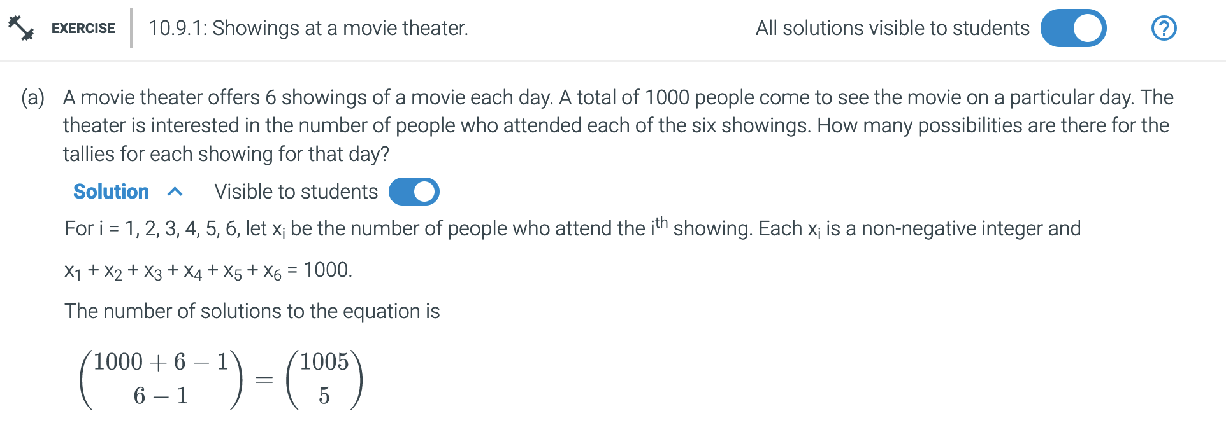
$$\left({n+m −1 \atop m−1}\right)$$
n = |S|
m = |x|

Slide 58
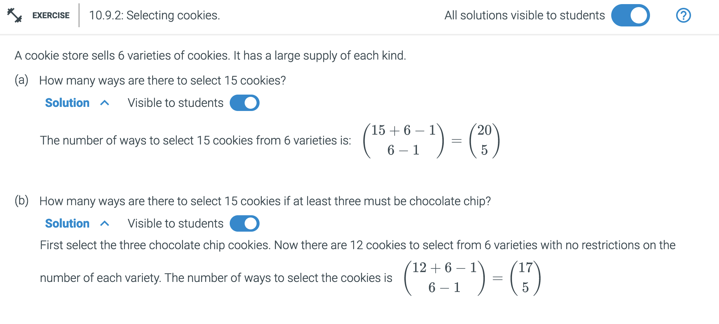
$$\left({n+m −1 \atop m−1}\right)$$
n = |S|
m = |x|

Slide 59
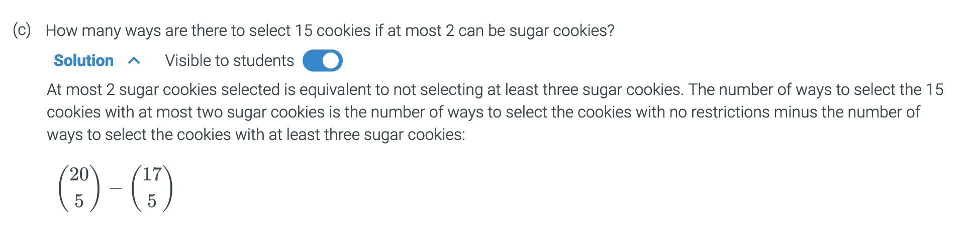
Remember Counting by Complement

Slide 60
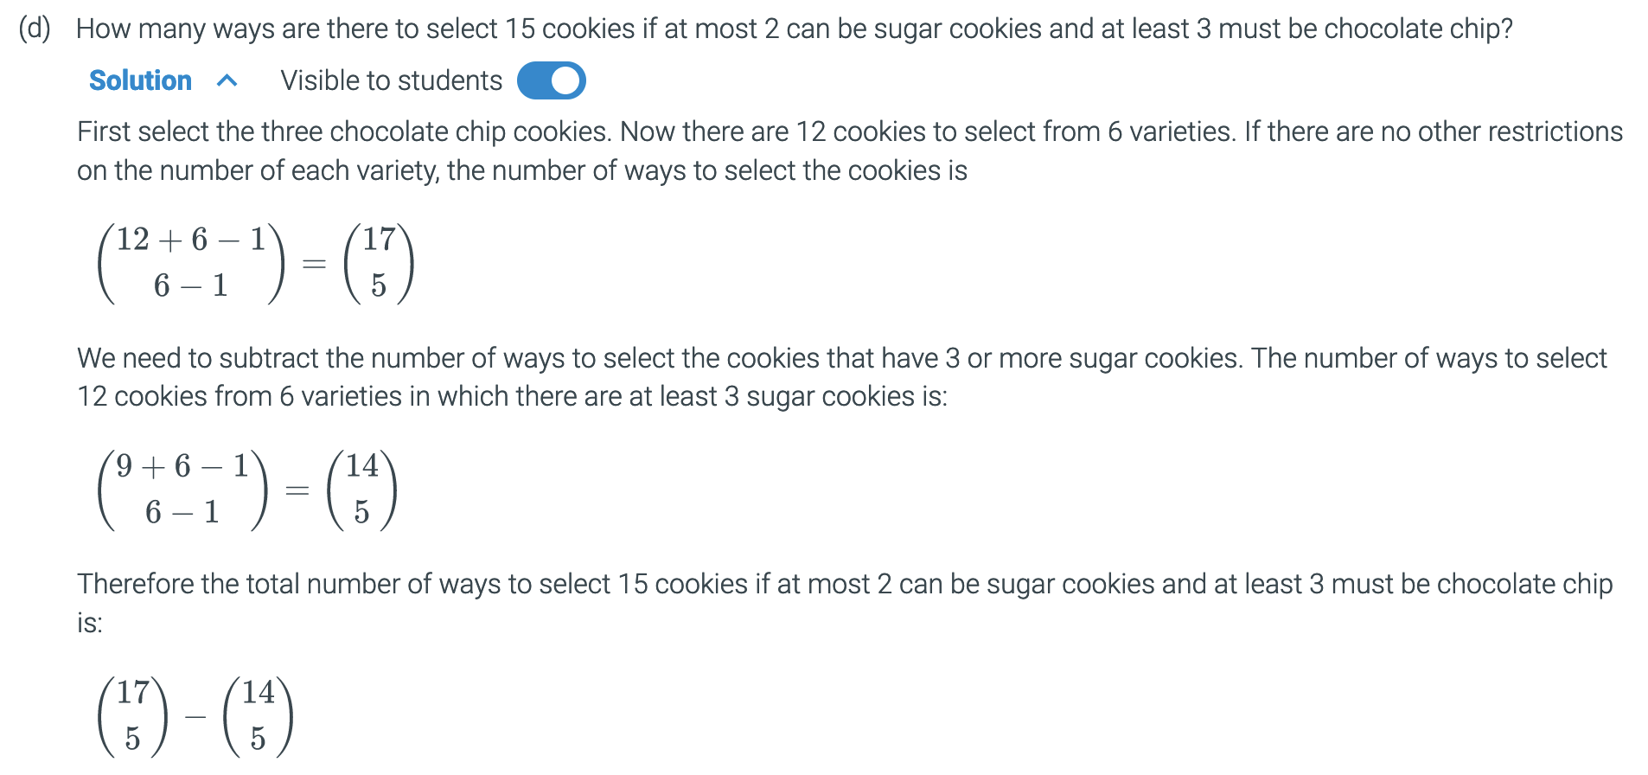
Where to start? Which cookies?

Slide 62
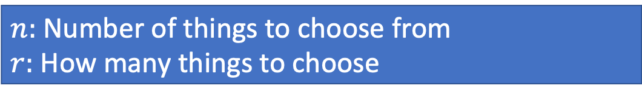

10.1-9 Sum and product rules
Order matters
$$P\left(n,r\right)=\frac{n!}{\left(n−r\right)! }$$
Order does not matter
$$C\left(n,r\right)=\left({n \atop r}\right)=\frac{n!}{r!\left(n−r\right)! }$$
"$n choose r"$
Introduction to counting
$$\frac{n!}{n_{1!}n_{2!}⋯n_{k}!}$$
$n:$ Number of things to choose from
$r:$ How many things to choose
Permutations with repetitions
Multisets / Multichoosing
$n$ = number of items to select
$m$ = number of varieties
$$\left({n+m −1 \atop m−1}\right)=\frac{\left(n+m−1\right)!}{\left(m−1\right)!\left(n+m−1 −\left(m−1\right)\right)!}= \frac{\left(n+m−1\right)!}{\left(m−1\right)!n!}$$

Slide 63
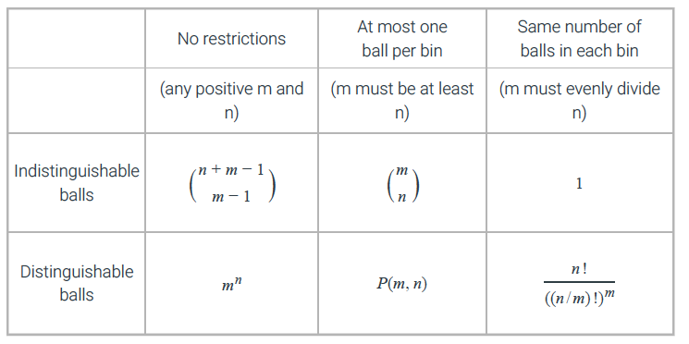
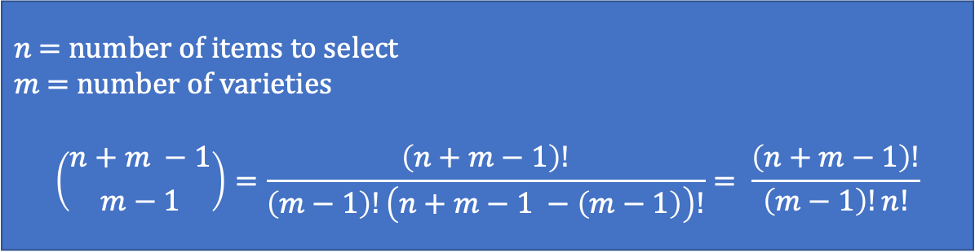
Assignment problems: Balls in bins
$n$ = number of items to select
$m$ = number of varieties
$$\left({n+m −1 \atop m−1}\right)=\frac{\left(n+m−1\right)!}{\left(m−1\right)!\left(n+m−1 −\left(m−1\right)\right)!}= \frac{\left(n+m−1\right)!}{\left(m−1\right)!n!}$$
abstractly by asking about the number of ways to place n balls into m different bins.
Order matters
$$P\left(n,r\right)=\frac{n!}{\left(n−r\right)! }$$

Slide 64
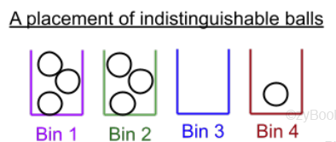
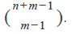
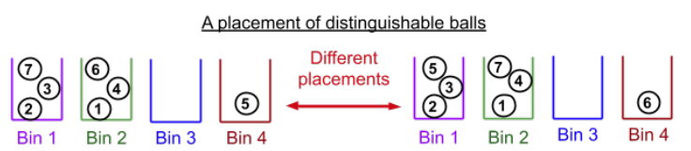
Balls in bins: No restrictions on the number of balls per bin.
The picture below shows a placement of 7 indistinguishable balls into bins.
The only thing that makes one placement different from another is the number of balls in each bin.
A placement can therefore be represented as a multi-set.
For example, the placement shown below can be expressed as {1, 1, 1, 2, 2, 2, 4}.
The order of the numbers in the multi-set is not important because the only factor that makes one multi-set different from another is the number of 1's, 2's, 3's, and 4's.
For n balls and m bins, the number of different placements is

Slide 65
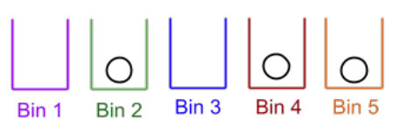

10.10.3: Balls in bins: At most one ball per bin.
Order does not matter
$$C\left(n,r\right)=\left({n \atop r}\right)=\frac{n!}{r!\left(n−r\right)! }$$
"$n choose r"$
The picture shows a placement of 3 indistinguishable balls (n=3) into m distinguishable bins (m=5) with at most one ball per bin.
Each bin has 1 or 0 balls, so a placement can be specifed by indicating which subset of the bins gets a ball.
For example, the placement below can be expressed as {2, 4, 5}. Since the balls are all the same, the order of the bin numbers is not important.
The number of different placements of n balls into m bins with at most one ball per bin is equal to the number of n-subsets of the m bins which is $\left({m \atop n}\right)$.

Slide 66

The picture below shows a placement of 3 distinguishable balls (n=3) into m distinguishable bins (m=5) with at most one ball per bin.
The placement can be specified by the sequence (4, 5, 2) which is a 3-permutation from the set {1, 2, 3, 4, 5}.
The first number is the bin in which ball 1 is placed, the second number is the bin in which ball 2 is placed and the third number is the bin in which ball 3 is placed.
Bin numbers can not be repeated because at most one ball can be placed in each bin.
To count the number of ways to place the n balls, imagine placing the balls in order.
There are m choices of bins in which to place the frrst ball.
Once the first ball has been placed, there are m-1 choices of bins in which to place the second ball, m-2 for the third, etc.
The number of different placements is m.(m-1).(m-2)…(m-n+1) = P(m, n).
Order matters
$$P\left(n,r\right)=\frac{n!}{\left(n−r\right)! }$$

Slide 67




Balls in bins: Same number of balls per bin
If the number of balls in each bin is the same, there must be n/m balls in each bin.
The picture below shows a placement of 10 indistinguishable balls into 5 bins with exactly 2 balls in each bin. Since the number of balls in each bin is determined and the balls are all identical, there is nothing to decide about the placement. Therefore, there is only one way to place the balls.
The picture below shows a placement of 10 distinguishable balls into 5 bins with exactly 2 balls in each bin.
An assignment can be expressed as a permutation with repetitions: (3, 5, 3, 4, 2, 1, 5, 4, 1, 2).
The j number is the bin in which ball j is placed. Since there are exactly 2 balls in each bin, there are two of each number 1 through 5.
To count the number of placements, first select the two balls that will go in bin 1. Then from the remaining 8 balls, select the 2 that will go in bin 2. Keep selecting two balls for each bin until there are only two remaining balls for the last bin. The total number of ways to select the placement is
$$\frac{n!}{n_{1!}n_{2!}⋯n_{k}!}$$

Slide 68

Uses
Scheduling Optimization
Resource Optimization

Slide 69

Inclusion-exclusion principle
The principle of inclusion-exclusion is a technique for determining the cardinality of the union of sets that uses the cardinality of each individual set as well as the cardinality of their intersections.
Principle 10.11.1: The inclusion-exclusion principle with two sets.
Let A and B be two finite sets, then |A ∪ B| = |A| + |B| - |A ∩ B|

Slide 70





Slide 71
Stars and bars example
Ice cream or money

Slide 72
Python Practice
Write a function to calculate combinations (e.g., "n choose k")
example

Slide 73

Probability - Introduction
Sample Space – The set of all possible outcomes
Event – A subset of the probability space
Assuming all outcomes in the sample space are equally likely:
Probability of event E is:
$$P\left(E\right)=\frac{length\left(E\right)}{length\left(Space\right)}$$
Another way to think about it:
$$P\left(E\right)= \frac{Number of successful outcomes}{Number of possible outcomes}$$
The probability of an event is a number between 0 and 1
Rosen, Kenneth. Discrete Mathematics and Its Applications, 7th Edition. McGraw-Hill, 2012

Slide 74

Example:
Suppose a jar contains 9 Skittles, 4 green and 5 red. What is the probability that a randomly chosen Skittle will be green?
Sample space = {g1, g2, g3, g4, r1, r2, r3, r4, r4}
Event = {g1, g2, g3, g4}
P(E) = len(Event) / len(Space) = 4/9 = 0.444444...
Rosen, Kenneth. Discrete Mathematics and Its Applications, 7th Edition. McGraw-Hill, 2012

Slide 75
Work on Exercise Set as a Team

Slide 76


Rolling dice – Does order matter?
Let's talk about flipping coins:
If order doesn't matter, then here is our sample space when flipping two coins:
{HH, HT, TT}
The probability of getting one H and one T would be 1/3. This is clearly incorrect.
It's not so much that order matters, but that we need to distinguish the outcomes of two different variables. Coin #1 and Coin #2. We need to treat them as if order does matter.
{HH, HT, TH, TT}
Now the probability of getting one H and one T is 2/4 = 1/2, which is correct.
https://math.stackexchange.com/questions/2428759/why-does-order-matter-when-two-dice-are-rolled

Slide 77
Yahtzee – Does order matter?
Just like flipping coins, if we roll five dice, we have five different variables. So we need to treat the problem as if order does matter in order to easily distinguish between the five dice.
If not, then our sample space does not equally represent all possible rolls.
(1,1,1,1,1) is not as likely as (1,2,3,4,5) because (1,1,1,1,1) can only happen one way, but (1,2,3,4,5) can happen 5!=120 ways.
Show with Python

Slide 78
Work on Exercise Set as a Team

